Slide 1
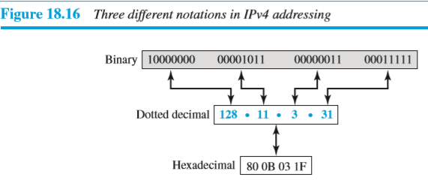
IPv4 Addressing : Address Space
An IPv4 address is a 32-bit address used to uniquely identify a host or a router on the Internet.
IP addresses are globally managed by Internet Assigned Numbers Authority(IANA).
Address Space:
An address space is the total number of addresses used by the protocol.
IPv4 uses 32-bit addresses, which means that the address space is 2³² or 4,294,967,296 (more than four billion)
Notations:

Slide 2
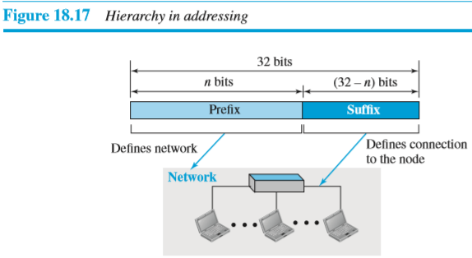
IPv4 Addressing :Address Space
Hierarchy in Addressing:
A 32-bit IPv4 address is divided into two parts.:
The first part of the address, called the prefix, defines the network;
the second part of the address, called the suffix, defines the host(node)
A prefix can be fixed length in Classful Addressing
A prefix can be variable length in Classless Addressing

Slide 3
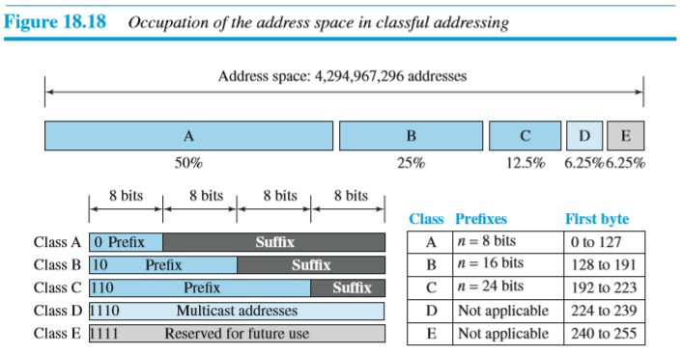
IPv4 Addressing:Classful Addressing
In classful addressing address space is divided into five classes :class A, B, C, D, and E
In class A, one byte defines the netid (prefix) and three bytes define the hostid (suffix).
In class B, two bytes define the netid and two bytes define the hostid.
In class C, three bytes define the netid and one byte defines the hostid.

Slide 4
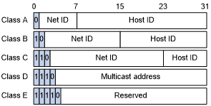
IPv4 Addressing:Classful Addressing
The IPv4 address is divided into two parts:
Network ID
Host ID
Classful Addressing
In classful addressing address space is divided into five classes :class A, B, C, D and E
Classes A, B, and C are used by the majority of devices on the Internet
Classes D and E are reserved for multicast and experimental purposes respectively.
Each of these classes has a valid range of IP addresses.

Slide 5
IPv4 Addressing:Classful Addressing
Class A :
IP addresses belonging to class A are assigned to the networks that contain a large number of hosts.
The network ID is 8 bits long.
The host ID is 24 bits long.
The first bit of the first octet in class A is always set to 0. The remaining 7 bits in the first octet are used to determine network ID. The 24 bits of host ID are used to determine the host in any network
IP addresses belonging to class A ranges from 0.0.0.0 – 127.255.255.255.

Slide 6
IPv4 Addressing:Classful Addressing
Class B
IP address belonging to class B is assigned to networks that range from medium-sized to large-sized networks.
The network ID is 16 bits long.
The host ID is 16 bits long.
The higher-order bits of the first octet of IP addresses of class B are always set to 10.
The remaining 14 bits are used to determine the network ID and the 16 bits of host ID are used to determine the host in a network.
IP addresses belonging to class B ranges from 128.0.0.0 – 191.255.255.255.

Slide 7
IPv4 Addressing:Classful Addressing
Class C
IP addresses belonging to class C are assigned to small-sized networks.
The network ID is 24 bits long.
The host ID is 8 bits long.
The higher-order bits of the first octet of IP addresses of class C is always set to 110.
The remaining 21 bits are used to determine the network ID.
The 8 bits of host ID are used to determine the host in any network.
IP addresses belonging to class C range from 192.0.0.0 – 223.255.255.255.

Slide 8
IPv4 Addressing:Classful Addressing
Class D
IP address belonging to class D is reserved for multi-casting.
The higher-order bits of the first octet of IP addresses belonging to class D is always set to 1110.
IP addresses belonging to class D range from 224.0.0.0 – 239.255.255.255.
Class E
IP addresses belonging to class E are reserved for experimental and research purposes.
The higher-order bits of the first octet of class E are always set to 1111.
IP addresses of class E range from 240.0.0.0 – 255.255.255.255

Slide 9
IPv4 Addressing:Classful Addressing
In classful addressing each class is divided into a fixed number of blocks with each block having a fixed size as shown in Table.
Table : Number of blocks and block size in classful IPv4 addressing
Class | Leading Bits | Network Identifier Bits | Actual Network Identifier Bits | No. of Blocks or Max. number of Networks | Host Identifier Bits | Block Size or Max. number of hosts | Range of IP Address in Dotted decimal notations | Application
A | 0 | 8 | 7 | 2⁷=128 | 24 | 2²⁴=1,67,77,216 | 0.0.0.0 to 127.255.255.255 | Unicast(Large organizations)
B | 10 | 16 | 14 | 2¹⁴=16,384 | 16 | 2¹⁶=65,536 | 128.0.0.0 to 191.255.255.255 | Unicast(Midsize organizations)
C | 110 | 24 | 21 | 2²¹=20,97,152 | 8 | 2⁸=256 | 192.0.0.0 to 223.255.255.255 | Unicast(Small organizations)
D | 1110 | - | - | - | - | - | 224.0.0.0 to 239.255.255.255 | Multicasting
E | 1111 | - | - | - | - | - | 240.0.0.0 to 255.255.255.255 | Reserved for future use

Slide 10
IPv4 Addressing:Classful Addressing
Problems with Classful Addressing
The problem with this classful addressing method is that millions of class A addresses are wasted,
Thousands of the class B addresses are wasted, whereas,
The number of addresses available in class C is so small that it cannot satisfy the needs of organizations.
Class D addresses are used for multicast routing and are therefore available as a single block only.
Class E addresses are reserved.
Because of these problems, Classful addressing was replaced by Classless Inter-Domain Routing (CIDR) in 1993.

Slide 11
IPv4 Addressing:Classful Addressing:
Subnet Mask:
The purpose of subnet mask is to identify which part of an IP address is network part and which part is host part.
Subnet mask is a 32 bit number created by setting network bits to all 1s and setting host bits to all 0s.
Table : Default masks for classful addressing
The last column of Table shows the mask in the form /n where n can be 8, 16, or 24 in classful addressing.
This notation is also called slash notation or Classless Interdomain Routing (CIDR) notation.

Slide 12
IPv4 Addressing:Classful Addressing:
Example: Find the error, if any, in the following IPv4 addresses.
Solution:
a. There must be no leading zero (045).
b. There can be no more than four bytes in IP address.
c. Each number needs to be less than or equal to 255.
d. A mixture of binary notation and dotted-decimal notation is not allowed.

Slide 13
IPv4 Addressing:Classful Addressing:
Example :Find the class of each address.
a. 00000001 00001011 00001011 11101111
b. 11000001 10000011 00011011 11111111
c. 14.23.120.8
d. 252.5.15.111
Solution:
a. The first bit is 0. This is a class A address.
b. The first 2 bits are 1; the third bit is 0. This is a class C address.
c. The first byte is 14; the class is A.
d. The first byte is 252; the class is E.

Slide 14
IPv4 Addressing:Classful Addressing
Address Depletion(Reduction in addresses):
Due to address depletion, classful addressing is no longer useful and is replaced with classless addressing.
To solve problem of address depletion, two strategies were proposed and, to some extent, implemented: Subnetting and Supernetting
Subnetting divides one large network into multiple small networks.
Supernetting combines multiple small networks into one larger network.

Slide 15
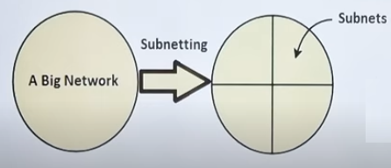
Subnetting
Subnetting :The practice of dividing a one network into two or more networks is called Subnetting
In subnetting,a large network is divided into smaller subnetworks,each with its own subnet address
Types of Subnetting:
Fixed Length Subnetting:
Fixed length subnetting (classful subnetting) divides network into subnets such that:
All the subnet are of same size
All the subnet have equal number of hosts
All the subnet have same subnet mask
Variable Length Subnetting
Variable length subnetting (classless subnetting) divides network into subnets such that:
All the subnet are not of same size
All the subnet do not have equal number of hosts
All the subnet do not have same subnet mask

Slide 16
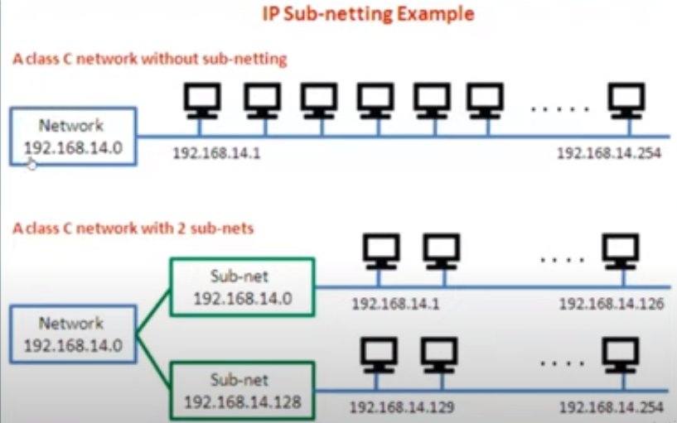
Subnetting
For Example 1: Consider the network having IP address 192.168.14.0. Divide this network into 2 equal subnets

Slide 17
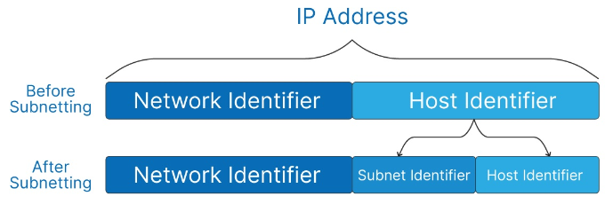
Subnetting

Slide 18
Subnetting
For Example 1: Consider the network having IP address 192.168.14.0. Divide this network into 2 equal subnets
Subnet mask: 11111111 11111111 11111111 10000000
255.255.128.0
1st subnet 2nd subnet
Network address of subnet/Subnet id: Network address of subnet/Subnet id:
192.168.14.00000000=192.168.14.0 192.168.14.10000000=192.168.14.128
Broadcast address of subnet: Broadcast address of subnet:
192.168.14.01111111=192.168.14.127 192.168.14.11111111=192.168.14.255
Valid hosts: 2^{n} - 1 =2⁷ -2=128-2=126 Valid hosts:2^{n} -1 =2⁷ -2=128-2=126
Valid range of IP address: Valid range of IP address:
192.168.14.1 to 192.168.14.126 192.168.14.129 to 192.168.14.254

Slide 19
Subnetting
For Example 2: Consider the network having IP address 192.168.14.0. Divide this network into 4 equal subnets

Slide 20
Subnetting
For Example 3: Consider the network having IP address 192.168.14.0. Divide this network into 3 subnets, such that first subnet consists 126 hosts and other two consists 62 hosts
1st subnet 2nd subnet
Network address of subnet/Subnet id: Network address of subnet/Subnet id:
192.168.14.00000000=192.168.14.0 192.168.14.10000000= 192.168.14.128
Broadcast address of subnet: Broadcast address of subnet :
192.168.14.01111111=192.168.14.127 192.168.14.10111111= 192.168.14.191
Valid hosts: 2^{n} - 1 =2⁷ -2=128-2=126 Valid hosts:2^{n} -1 = 2⁶ -2 = 64-2 = 62
Valid range of IP address: Valid range of IP address:
192.168.14.1 to 192.168.14.126 192.168.14.129 to 192.168.14.190
3rd subnet
Network address of subnet/Subnet id:
192.168.14.11000000=192.168.14. 192
Broadcast address of subnet:
192.168.14.11111111=192.168.14.255
Valid hosts: 2^{n} - 1 =2⁶ -2=64- 2=62
Valid range of IP address
192.168.14.193 to 192.168.14.254

Slide 22
Subnetting
Uses of Subnetting in Computer Networks:
Subnetting can improve network performance by reducing network congestion and improving routing efficiency
Subnetting can improve network security by separating different parts of the network into smaller subnetworks, making it harder for unauthorized access.
Subnetting can improve routing efficiency by allowing routers to route traffic directly to the appropriate subnet instead of broadcasting it to the entire network

Slide 23
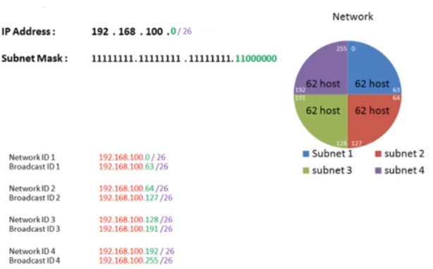

Slide 24
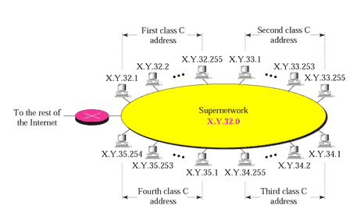
Supernetting
Supernetting combines multiple small networks into one larger network.
The class C network has maximum 256 addresses which may not satisfy the need of organization
One solution is supernetting,In supernetting,an organization can combine several class C network to create large range of addresses,In other word, several networks are combined to create a supernetwork.
For example an organization that needs 1000 addresses can be granted four class C blocks.
The organization can then use these addresses in one supernetwork as shown in fig.
Fig.A Supernetwork

Slide 25
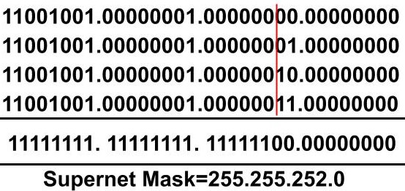
Supernetting
Example: Suppose we have four small networks with network ID as
201.1.0.0,
201.1.1.0,
201.1.2.0,
201.1.3.0.
These four networks can be combined to form a supernet.
The supernet ID for all the four networks will be 201.1.0.0
Supernet Mask
Supernet Mask is a 32-bit number where all the fixed bits of the network are represented by 1 and the variable part is represented by 0.

Slide 26
Supernetting
For Example:
Consider four small networks:
192.128.197.0/24,
192.128.198.0/24,
192.128.199.0/24,
192.128.200.0/24,
and we want to combine these four networks into one supernet.
192.128.11000101.0/24
192.128.11000110.0/24
192.128.11000111.0/24
192.128.11001000.0/24
192.128.11000000.0
192.128.192.0/20

Slide 27
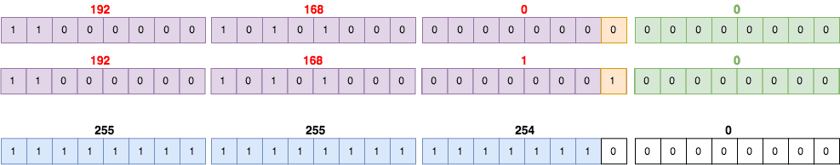
Supernetting
Supernetting combines multiple small networks into one larger network.
There are three rules for Supernetting:
Contiguous : All the networks should be contiguous.
Same size: All the networks should be of the same size and also a power of 2 i.e. 2^n.
Divisibility: The first network ID should be divisible by the size of the block.
For Example: Consider two networks:192.168.0.0/24 and 192.168.1.0/24 and we want to combine these two networks into one supernet.
These two networks are the same all the way up to the 23rd bit (counting from the left side). The 24th bit is where the difference is (highlighted in orange). Therefore, the subnet mask of the new supernet will be 1 all the way up to the 23rd bit and then 0 from there:
Therefore, the supernet is (192.168.0.0) with the new subnet mask as: 192.168.0.0/23.

Slide 28
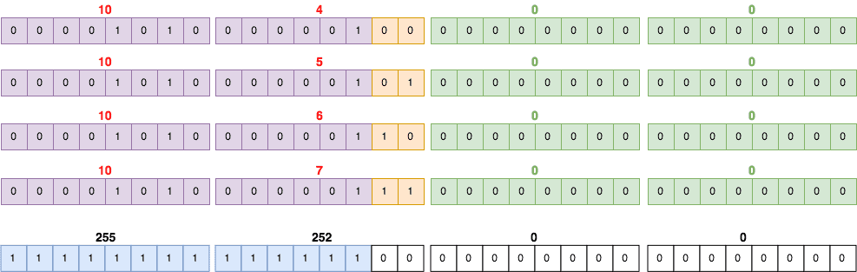
Supernetting
For Example:
Consider four networks:
10.4.0.0/16,
10.5.0.0/16,
10.6.0.0/16,
10.7.0.0/16.
These networks are the same up to the 14th bit. Therefore, the supernet is 10.4.0.0/14

Slide 29
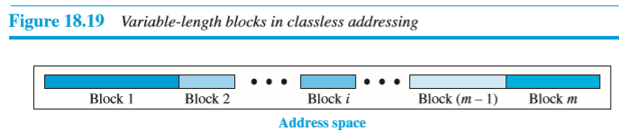
IPv4 Addressing : Classless addressing
In Classless addressing, the whole address space is divided into variable length blocks.
The prefix in an address defines the block (network); the suffix defines the node (hosts).
We can have a block of 1 address, 2 addresses, 4 addresses, 8 addresses, and so on.
Restrictions on classless address blocks:
The addresses in block must contiguous , one after another.
The number of addresses in a block needs to be a power of 2.
The first address must be evenly divisible by the number of addresses.

Slide 30
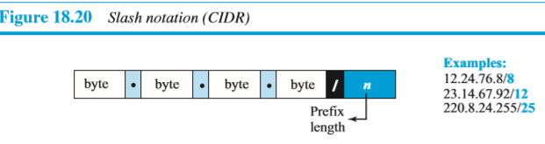
IPv4 Addressing : Classless addressing
Prefix Length: Slash Notation
In classless addressing prefix length is variable.
We can have a prefix length that ranges from 0 to 32.
In classless address, the prefix length, n, is added to the address, separated by a slash.
The notation is informally referred to as slash notation and formally as classless interdomain routing or CIDR (pronounced cider) strategy
An address in classless addressing can be represented as shown in Figure 18.20.

Slide 31
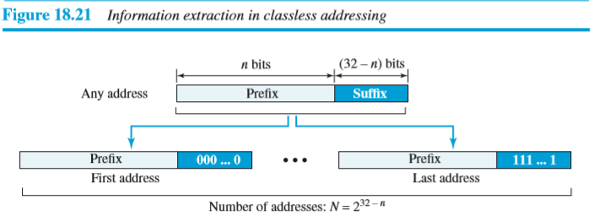
IPv4 Addressing: Classless addressing
Extracting Information from an Address:
1.The number of addresses in the block is found as N = 2^{32−n}.
2. To find the first address, we keep the n leftmost bits as its and set the (32 − n) rightmost bits all to 0s.
3. To find the last address, we keep the n leftmost bits as its and set the (32 − n) rightmost bits all to 1s

Slide 32
IPv4 Addressing: Classless addressing
Extracting Information from an Address:
Example:
A classless address is given as 167.199.170.82/27. find number of addresses in the block, first address and last address in block.
We can find the above three pieces of information as follows.
The number of addresses in the block are: 2^{32 − n} = 2³² ⁻ ²⁷ = 2⁵ = 32 addresses.
The first address can be found by keeping the first 27 bits in address as its and setting the rest of the bits to 0s.
The last address can be found by keeping the first 27 bits in address as its and setting the rest of the bits to 1s.
IP Address: 167.199.170.82/27 10100111 11000111 10101010 01010010
First address: 167.199.170.64/27 10100111 11000111 10101010 01000000
Last address: 167.199.170.95/27 10100111 11000111 10101010 01011111
The first address in a block is normally not assigned to any host; The first address is called as the network address that represents the organization itself to the rest of the world.
The last address in a block is normally not assigned to any host; The last address is called as the broadcast address used to send packets to all hosts in a particular network.

Slide 33
IPv4 Addressing: Classless addressing
Example :A block of addresses is granted to a small organization. We know that one of the addresses is 205.16.37.39/28. What is the first address in the block?
Solution
The binary representation of the given address is
11001101 00010000 00100101 00100111
If we set 32−28 rightmost bits to 0, we get
11001101 00010000 00100101 0010000
or 205.16.37.32.

Slide 34
IPv4 Addressing: Classless addressing
Example: Find the last address for the block in 205.16.37.39/28.
Solution
The binary representation of the given address is
11001101 00010000 00100101 00100111
If we set 32 − 28 rightmost bits to 1, we get
11001101 00010000 00100101 00101111
or
205.16.37.47

Slide 35
IPv4 Addressing: Classless addressing
Example :Find the number of addresses for the block in 205.16.37.39/28.
Solution: The number of addresses in the block can be found by using the formula 2^{32−n}
The value of n is 28, which means that number of addresses are= 2 ³²⁻²⁸
=2⁴
= 16

Slide 36
Example 19.9
Another way to find the first address, the last address, and the number of addresses is to represent the mask as a 32-bit binary number.
In Example 205.16.37.39/28
the /28 can be represented as
11111111 11111111 11111111 11110000
(twenty-eight 1s and four 0s).
Find
a. The first address
b. The last address

Slide 37
Example 19.9 (continued)
Solution
a. The first address can be found by ANDing the given addresses with the mask. ANDing here is done bit by bit. The result of ANDing 2 bits is 1 if both bits are 1s; the result is 0 otherwise.

Slide 38
Example 19.9 (continued)
b. The last address can be found by ORing the given addresses with the complement of the mask. ORing here is done bit by bit. The result of ORing 2 bits is 0 if both bits are 0s; the result is 1 otherwise. The complement of a number is found by changing each 1 to 0 and each 0 to 1.

Slide 39
IPv4 Addressing
Classful Addressing | Classless Addressing
In classful addressing address space is divided into five classes :class A, B, C, D, and E, each class is divided into a fixed length blocks | In classless addressing, the whole address space is divided into variable length blocks.
it allocates IP addresses according to five major classes such as Class A,B,C,D,E | Its IP address allocation method designed to replace the classful addressing
It uses fixed length prefix | it uses variable length prefix
It uses fixed length subnet mask | it uses variable length subnet mask
Its less effective method of allocating IP addresses | Its more effective method of allocating IP addresses
Its less practical. | Its more practical.
It does not support Classless Inter-Domain Routing (CIDR). | It supports Classless Inter-Domain Routing (CIDR).
It requires more bandwidth . As a result, it becomes slower and more expensive as compared to classless addressing. | It requires less bandwidth. Thus, fast and less expensive as compared to classful addressing.

Slide 40
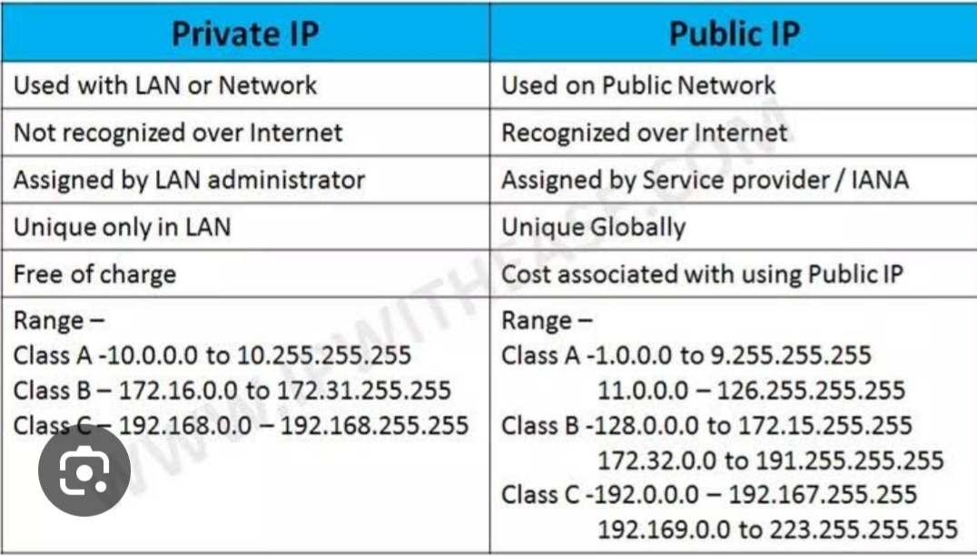
IPv4 Addressing

Slide 41
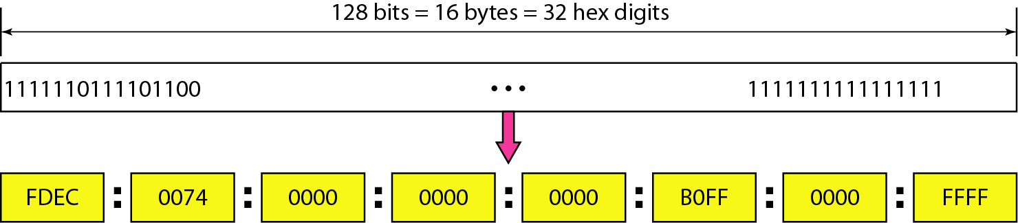
IPv6 Addressing: Representation
The main reason for migration from IPv4 to IPv6 is the small size of the address space in IPv4.
An IPv6 address is 128 bits or 16 bytes (octets) long, four times the address length in IPv4.
Representation:
There are several notations to represent IPv6 addresses.
The following figure shows two of these notations: binary and colon hexadecimal.
Figure . IPv6 address in binary and hexadecimal colon notation
Binary notation is used when the addresses are stored in a computer.
Colon hexadecimal notation (or colon hex for short) divides the address into eight sections, each made of four hexadecimal digits, separated by colons.

Slide 42
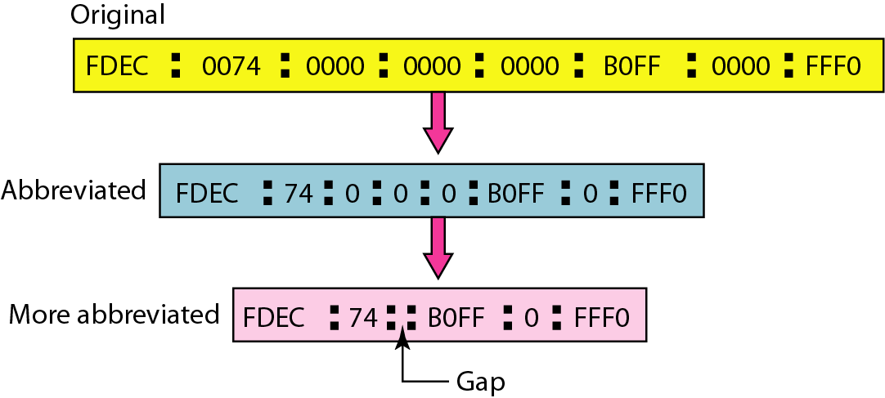
IPv6 Addressing: Representation
Abbreviation:
An IPv6 address, even in hexadecimal format, is very long, many of the digits are zeros. So, we can abbreviate the address.
The leading zeros of a section can be omitted.
Using abbreviation, 0074 can be written as 74, 000F can be written as F, and 0000 can be written as 0.
Note that 3210 cannot be abbreviated.
In more abbreviated form, If there are consecutive sections of zeros, we can remove all the zeros and replace them with a double colon .
.
Figure: Abbreviated IPv6 addresses

Slide 43
IPv6 Addressing: Representation
Mixed Notation:
Mixed representation of IPv6 address is combination of colon hex and dotted decimal notation.
In mixed notation, leftmost six sections are represented in colon hex notation and rightmost two sections are represented in dotted decimal notation.
For example:
1. 805B:2D9D:DC28:0000:0000:FC57:212.200.31.254
2. 805B:2D9D:DC28::FC57:212.200.31.254
When all of the leftmost six sections of the IPv6 address are 0s then the address
( ::130.24.24.18) is a valid address in IPv6.
CIDR Notation:
IPv6 uses hierarchical addressing. we can define a prefix length using CIDR notation .
For example, we can define a prefix of 60 bits using CIDR as shown below:
FDEC::BBFF:0:FFFF/60

Slide 44
IPv6 Addressing: Representation
Show colon hex notation for IPv6 addresses:
A) An address with 64 0’s followed by 64 1’s
0000:0000:0000:0000:FFFF:FFFF:FFFF:FFFF
B) An address with 64 1’s followed by 64 0’s
FFFF:FFFF:FFFF:FFFF:0000:0000:0000:0000
C) An address with 128 0’s
0000:0000:0000:0000:0000:0000:0000:0000
D) An address with 128 1’s
FFFF:FFFF:FFFF:FFFF:FFFF:FFFF:FFFF:FFFF

Slide 45
IPv6 Addressing: Representation
Show abbreviation for following IPv6 addresses:
A) 1234:2346:0000:0000:0000:0000:0000:1111
1234:2346::1111
B) 2001:0000:0000:0012:0000:0000:1234:56AB
2001::12:0:0:1234:56AB
C) 0000:0000:FFFF:0000:0000:0000:0000:0000
0:0:FFFF::

Slide 46
IPv6 Addressing: Representation
Example: Expand the address 0:15::1:12:1213 to its original.
Solution
We first need to align the left side of the double colon to the left of the original pattern and the right side of the double colon to the right of the original pattern to find how many 0s we need to replace the double colon.
This means that the original address is:

Slide 47
IPv6 Addressing: Address Space
The address space of IPv6 consists 2¹²⁸ addresses.
The size of the address space is :
340, 282, 366, 920, 938, 463, 374, 607, 431, 768, 211, 456.
This address space is 2⁹⁶ times more than IPv4 address-definitely there no address depletion.
we assume that only 1/64 (i.e. almost 2 percent) of the addresses in the address space can be assigned to the people on planet Earth and the rest are reserved for special purposes.
Three Address Types :In IPv6, a destination address can belong to one of three categories:
Unicast address : Unicast address used to defines a single computer.
The packet sent to a unicast address must be delivered to specific computer.
Anycast address : Anycast address defines a group of computers that all share a single address.
A packet send to a anycast address is delivered to only one member of the group, the most reachable one.
Multicast addresses :Multicast address also defines a group of computers.
A packet send to a multicast address is delivered to each member of the group.

Slide 48
Difference between IPv4 and IPv6 Protocol
IPv4 | IPv6
IPv4 addresses are 32 bits length. | IPv6 addresses are 128 bits length.
IPv4 address space is 2³² (i.e. 4.3 billion addresses) | IPv6 address space is 2¹²⁸ (i.e. 340 trillion trillion trillion addresses)
IPv4 addresses are represented in dotted decimal notation. | IPv6 addresses are represented in colon hexadecimal notation
Length of header is 20 to 60 bytes | Length of header is fixed 40 bytes
Checksum field is available in IPv4 header | No Checksum field in IPv6 header.
Options fields are available in IPv4 header. | In IPv6 option fields replaced with Extension headers
Fragmentation is done by sender and routers. | Fragmentation is done only by sender.
IPSec support is only optional. | Inbuilt IPSec support.
No packet flow identification. | Packet flow identification is available in the IPv6 header using the Flow Label field.
Manual (Static) or DHCP (Dynamic) is required to configure IPv4 addresses. | Auto-configuration of addresses is available.
Address Resolution Protocol (ARP) is available to map IPv4 addresses to MAC addresses. | Address Resolution Protocol (ARP) is replaced with a function of Neighbor Discovery Protocol (NDP).
Internet Group Management Protocol (IGMP) is used to manage multicast group membership. | IGMP is replaced with Multicast Listener Discovery (MLD) messages.
Broadcast messages are available. | Broadcast messages are not available.

Slide 49
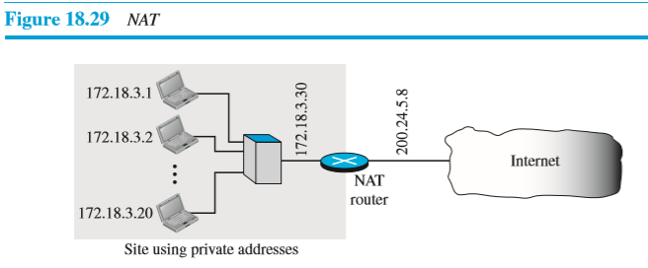
Network Address Translation (NAT)
Its process used to translates the private IP address to the public IP address and vice versa.
Due to NAT, the computers in a private network are able to communicate with the computer in the public network.
As the figure shows, the private network uses private addresses.
The router that connects the private network to the internet uses two addresses : one is private address and another is public(global) address.
The private network is invisible to the rest of the Internet;
the rest of the Internet sees only the NAT router with the address 200.24.5.8.

Slide 50
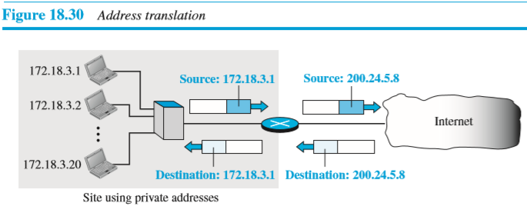
Network Address Translation (NAT)
Address Translation:
For every outgoing packet, NAT router, replaces the private source address in the packet with its global address and then packet forwarded to internet.
For every incoming packet ,NAT router, replaces the destination address in the packet with the appropriate private destination address and then packet is forwarded to particular destination in a private network. Figure 18.30 shows an example of address translation.

Slide 51
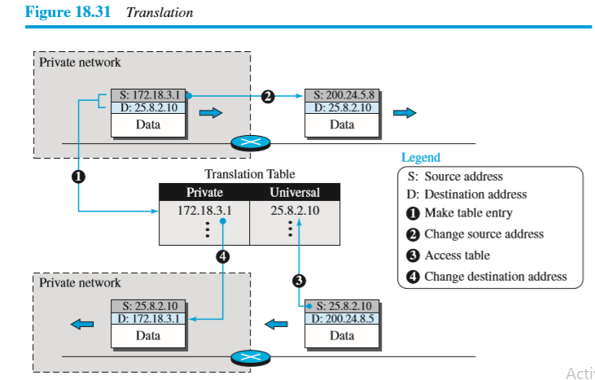
Network Address Translation (NAT)
Translation Table: It has two columns: the private address and the Universal(External) address
When the router translates the source address of the outgoing packet , it make note of source address and destination address(where the packet is going) of packet in translation table.
When the response comes back from the destination, the router uses the source address of the packet to find the private address of the packet. Figure 18.31 shows the idea.

Slide 52
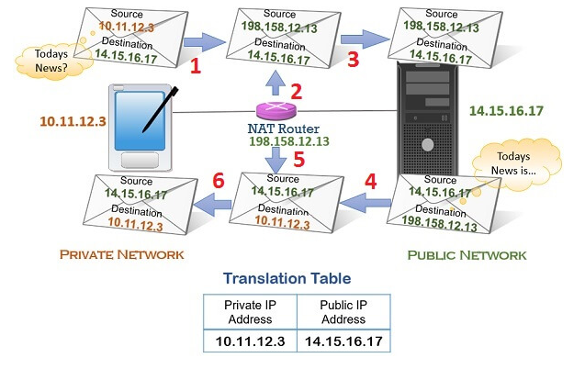
Network Address Translation (NAT)
Example of NAT : suppose, if the tablet user at home network wants the information about today’s news.

Slide 54
DHCP
DHCP stands for Dynamic Host Configuration Protocol.
DHCP runs at the application layer of the TCP/IP stack.
DHCP automatically assigns IP addresses and other TCP/IP configuration parameters to each device in a network.
other TCP/IP configuration parameters includes subnet mask, default gateway and DNS server addresses.

Slide 55
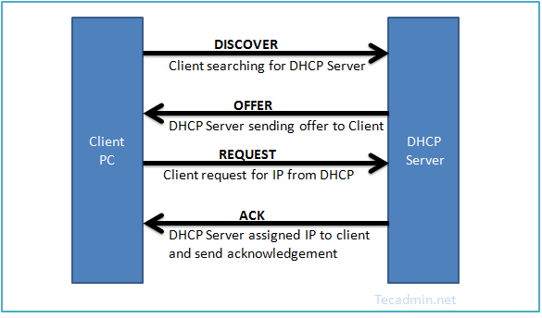
DHCP Operation
DHCP is based on a client-server architecture, where clients sends request for IP address to DHCP server and a DHCP server automatically assigns IP addresses and other TCP/IP configuration parameters to clients.
The DHCP Operation
The DHCP operation consists of four main steps:
Discover: When a client connects to a network, it broadcasts a DHCP Discover message to find available DHCP servers.
Offer: After receiving the Discover message, the DHCP server responds with a DHCP Offer message, proposing an IP address and other TCP/IP configuration parameters to the client.
Request: The client evaluates the Offer and sends a DHCP Request message to the server, indicating its acceptance of the proposed IP address and other TCP/IP configuration parameters.
Acknowledge: The server acknowledges the client’s request with a DHCP Acknowledge message, confirming the lease of the IP address and other TCP/IP configuration parameters

Slide 56
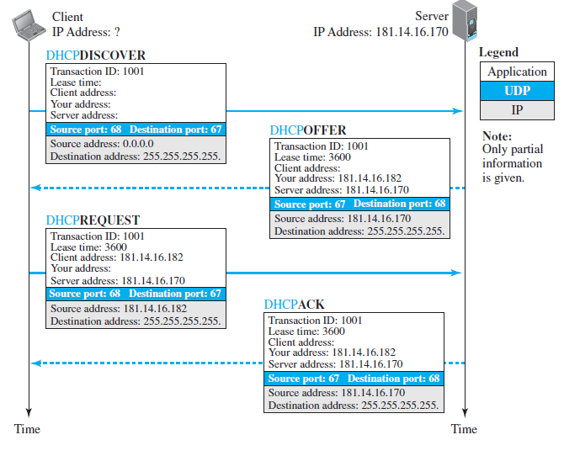
DHCP Operation

Slide 57
DHCP Allocation Methods
Following three types of IP address allocations are used by DHCP
Static allocation(Manual)-
In static allocation DHCP server assigns a fixed IP addresses to particular client.
It is done by configuring a DHCP server and choosing a Reserved Address to correspond to the MAC Address
for example, if we have a server in a LAN and we do not want its IP address to keep changing, then we need to use static address allocation.
Dynamic allocation-
DHCP server assigns a temporary IP address to client from a pool of addresses.
In dynamic allocation , IP address are allocated for a limited period of time known as lease.
if client wants to continue to use the IP address then lease must be renewed .
Automatic allocation-
The DHCP server automatically assigns a permanent IP address to a client from pool of addresses.
No lease expiration time applied to automatic allocation.

Slide 58
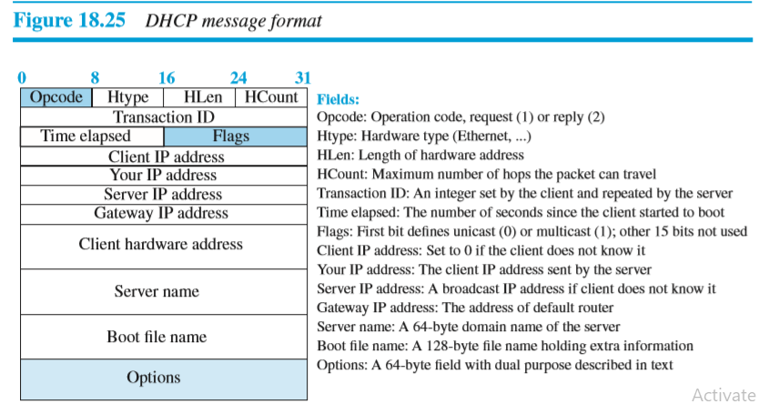
DHCP message format
DHCP Message Format :DHCP is a client-server protocol in which the client sends a request message and the server returns a response message

Slide 59
Advantages of DHCP
Centralized management of IP addresses and TCP/IP configuration-
If DHCP server configured properly, then it will automatically assign IP address and TCP/IP configuration parameters to every computer in a network.
Reduce efforts of network administrator-
The use of DCHP reduces the task of network administrator.
Network administrator has no need to visit every machine in a network and assign IP address and TCP/IP configuration parameters.
No duplicate IP addresses-
If the entire process of configuration of DHCP is done properly ,then there will be no a problem of a duplicate IP address.

Slide 60
Network Layer Services
Connection-Oriented Vs Connectionless Network Service
Delivery of a packet can be accomplished by using either a connection-oriented or a connectionless network service.
In a connection-oriented service, the source first makes a connection with the destination before sending a packet.
When the connection is established , then source sent a sequence of packets to destination one after another.
In connection-oriented service, there is a relationship between packets. Packets are sent on the same path in sequential order.
When all packets of a message have been delivered, the connection is terminated.
In a connection less service, the source does not makes any connection with the destination.
source sent a set of packets to destination without establishing connection with destination.
In connection-less service, there is a no relationship between packets. Packets are sent on the same path or on different path

Slide 61
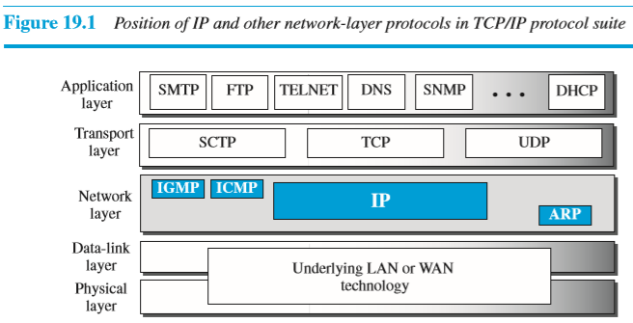
Network Layer Protocols
Internet Protocol version 4 (IPv4) is responsible for packetizing, forwarding, and delivery of a packet at the network layer.
The Internet Control Message Protocol version 4 (ICMPv4) helps IPv4 to handle some errors that may occur in the network-layer delivery.
The Internet Group Management Protocol (IGMP) is used to help IPv4 in multicasting.
The Address Resolution Protocol (ARP) is used mapping network-layer addresses to link-layer addresses. (it find MAC address of device from its IP address.)
Figure 19.1 shows the positions of these four protocols in the TCP/IP protocol suite.

Slide 62
Internet Protocol(IP)
IPv4 is an unreliable datagram protocol—a best-effort delivery service.
The term best-effort means that IPv4 packets can be corrupted, be lost, arrive out of order, or be delayed, and may create congestion for the network.
If reliability is important, IPv4 must be paired with a reliable protocol such as TCP.
An example of best-effort delivery service is the post office.
The post office does its best to deliver the letters but does not always succeed.
IPv4 is also a connectionless protocol that uses the datagram approach.
Datagram approach means that each datagram is handled independently, and each datagram can follow a different route to the destination.

